Slide 1

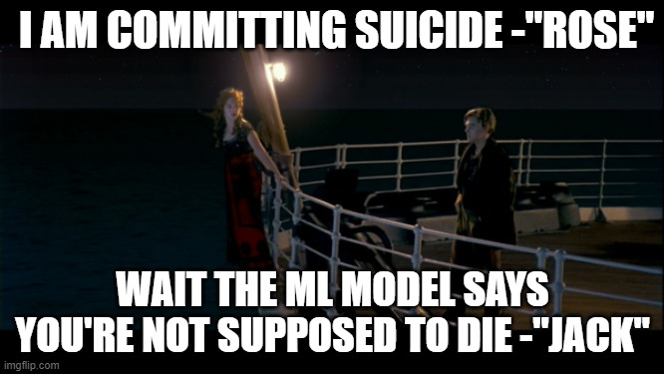
SURVIVAL ANALYSIS

Slide 2

SURVIVAL ANALYSIS BACKGROUND
Definition
A statistical method for studying the time to an event. The term “survival” suggests that the event of interest is death but the technique is useful for other types of events.

Slide 3
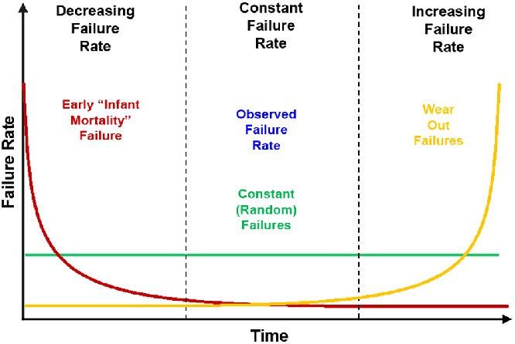
Alternative terminology
• Event analysis, Time series analysis, Time-to-event analysis
• Reliability theory / Reliability analysis (engineering)

Slide 4

Objectives of survival analysis
□ Estimate time-to-event for a group of individuals, such as time until second heart-attack for a group of MI patients.
□ To assess the relationship of co-variables to time-to-event, such as: does weight, insulin resistance, or cholesterol influence survival time of MI patients?

Slide 5
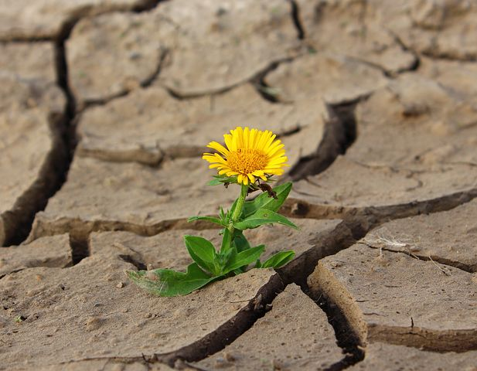
QUICK SCENARIOS:
●
How long will a patient ‘survive’ given pre-existing medical conditions and certain treatment ?
How long before a customer ‘makes’ a purchase given their surfing history ?
How long before a device ‘fails’ given the device characteristics ?
How long before a student ’drops out’ given their family history, grades, locality etc. ?
●
●
●

Slide 6

MORE SCENARIOS:
●
How long a person lives after surgery
How long a person is in remission from leukemia until relapse
How long a woman undergoing fertility treatments takes to get pregnant
●
●

Slide 7
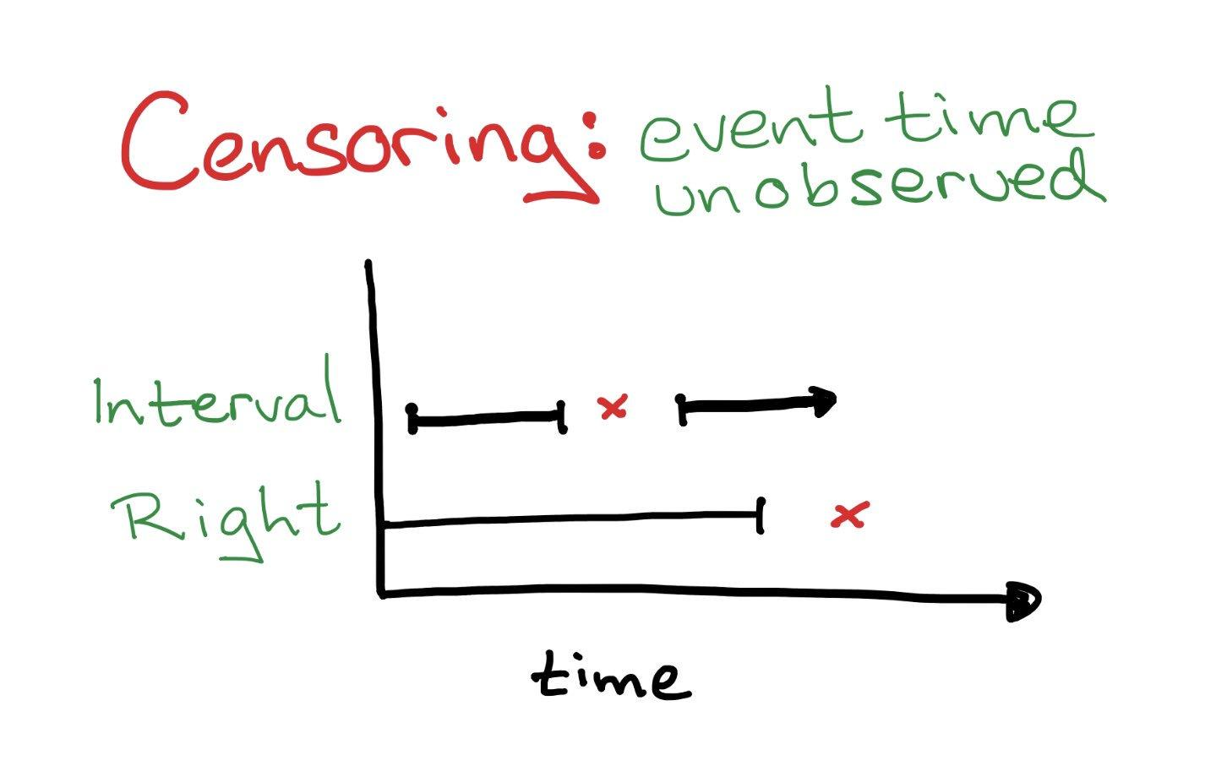
SURVIVAL ANALYSIS TERM
Time-to-event: The time from entry into a study until a subject has a particular outcome
Censoring: Censoring occurs when we don’t know the exact time-to-event for an included observation.

Slide 8

WHY SPECIAL METHODS?
●
Logistic regression can predict the presence or absence of events but not time until events and it can not handle time dependent covariates.
Linear regression can not handle censoring well or time dependent covariates or the fact that time can only be positive.
●

Slide 9

Inputs to survival models
● X : Covariates (Area, Mobile device, etc.)
● T : Time
● E : Event

Slide 10

SOME OF THE OPEN-SOURCE PYTHON LIBRARIES FOR SURVIVAL ANALYSIS
LIFELINES
SCIKIT - SURVIVAL
PY-SURVIVAL

Slide 11
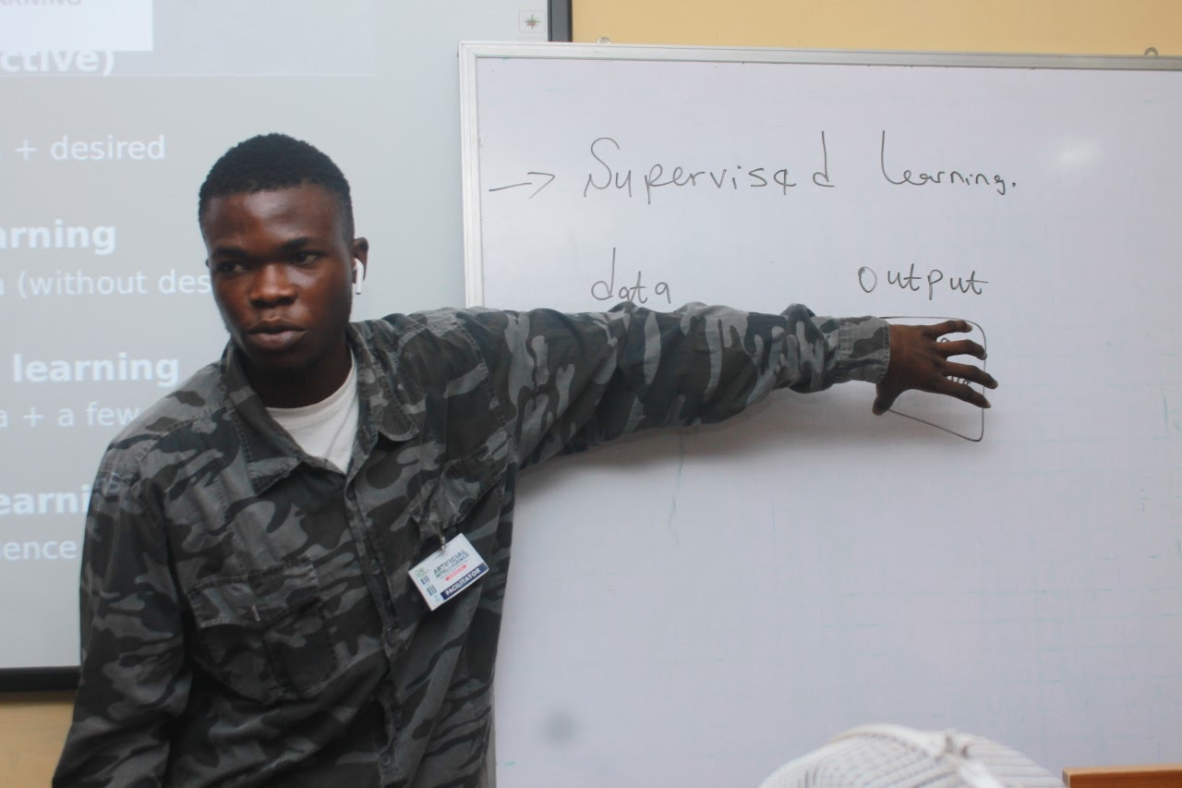



OLALEYE ENIOLA
Data Scientist
@galileo.eni
https://www.linkedin.com/in/eniola-olaleye-361b39160/
eniolaolaleye426@gmail.com

Slide 12
THANK YOU

